Slide 1
MOB DEVICES VUL & MITIGATION
Lesson 61
Intro : Mob Device Security
Last Updation Dt : 08 Jan 25

Slide 2
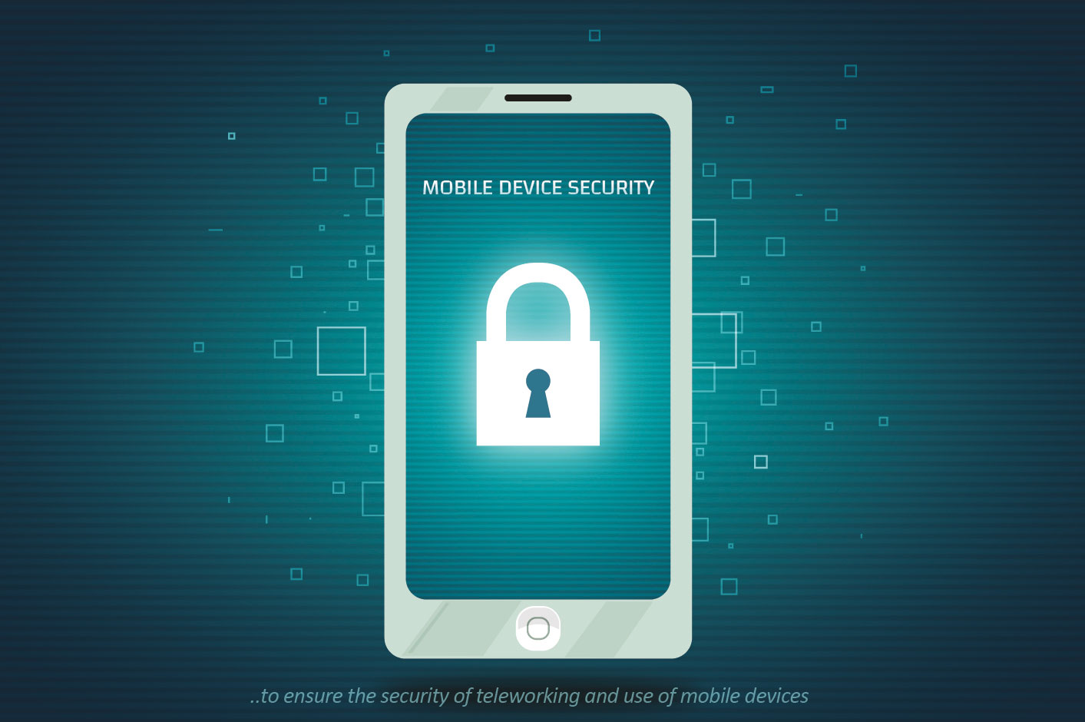
LESSON PREVIEW
Intro to Mob OS Arch
File Structure
Versions
Security Features
Current Mkt Ldrs
Comparison of Apps
Tracking Vulnerabilites in Smart Phs

Slide 3
PD 3 : CURRENT MKT LDRS, COMPARISON OF APPS & TRACKING VULNERABILITIES IN SMART PHS

Slide 4

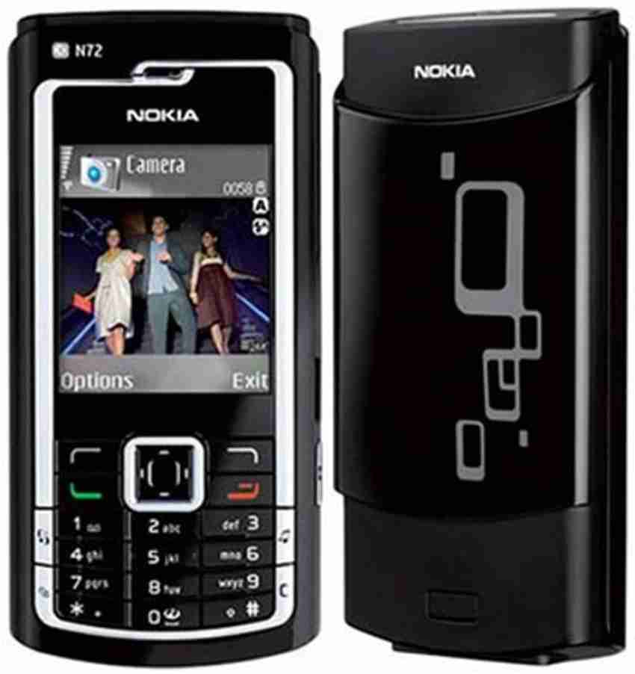
THE RISE OF SMART PHONE
Touchscreen smartphone revolution began around 2010.
Sales of smartphones grew from 139 million units in 2008 to 1.39 billion units in 2023.
Smartphone sales dipped to 1.38 billion units in 2020 due to the COVID-19 pandemic.
Big winners: Apple, Samsung, and Xiaomi.
Missed opportunities: BlackBerry and Nokia.
Notes:
From around 2010, the touchscreen smartphone revolution had a major impact on sales of basic feature phones, as the sales of smartphones increased from 139 million units in 2008 to 1.39 billion units in 2023. In 2020, smartphone sales decreased to 1.38 billion units due to the coronavirus (COVID-19) pandemic. Apple, Samsung, and lately also Xiaomi, were the big winners in this shift towards smartphones, with BlackBerry and Nokia among those unable to capitalize.

Slide 5
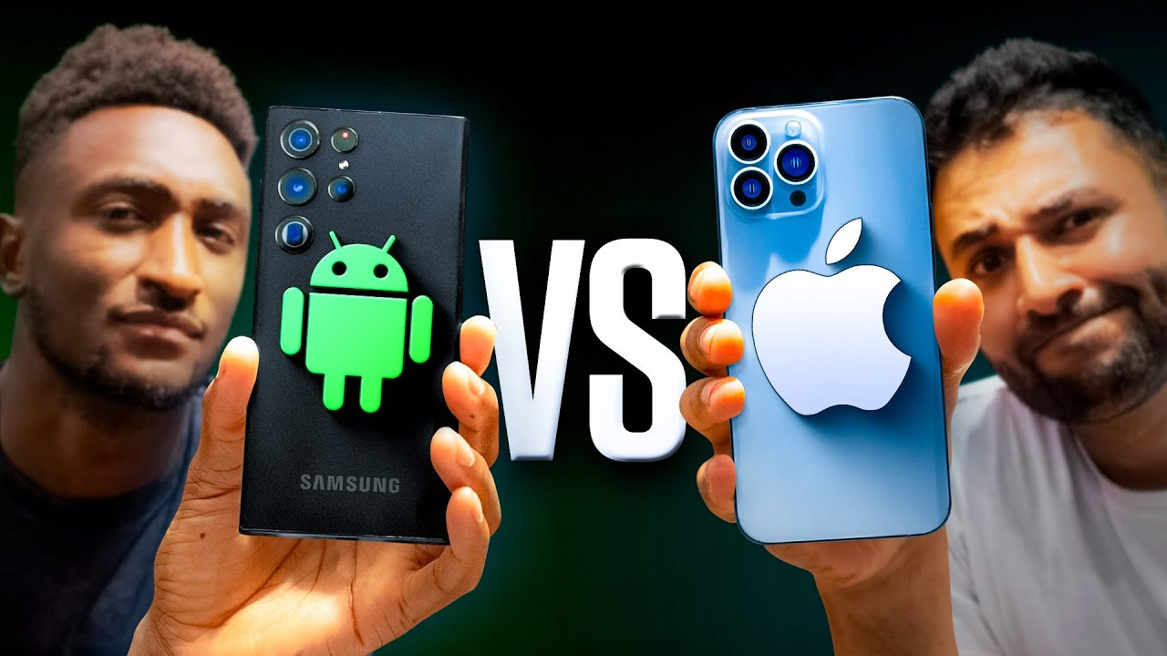
EVOLUTION OF iOS AND ANDROID
Both iOS and Android launched in 2007 and have evolved with incremental updates.
Latest Versions.
iOS 18 (released Sep 24)
Android 15 (released Sep 23)
Key Difference in Hardware.
iOS. Exclusive to Apple devices.
Android. Available on devices from multiple manufacturers (e.g., Samsung, Google, OnePlus).
Notes:
Both unveiled in 2007, Google’s Android and Apple’s iOS have evolved through incremental updates introducing new features and capabilities. The latest version of iOS, iOS 18, was released in September 2024, while the most recent Android iteration, Android 15, was made available in September 2023. A key difference between the two systems concerns hardware - iOS is only available on Apple devices, whereas Android ships with devices from a range of manufacturers such as Samsung, Google and OnePlus. In addition, Apple has had far greater success in bringing its users up to date. As of February 2024, 66 percent of iOS users had iOS 17 installed, while in the same month only 13 percent of Android users ran the latest version.

Slide 6
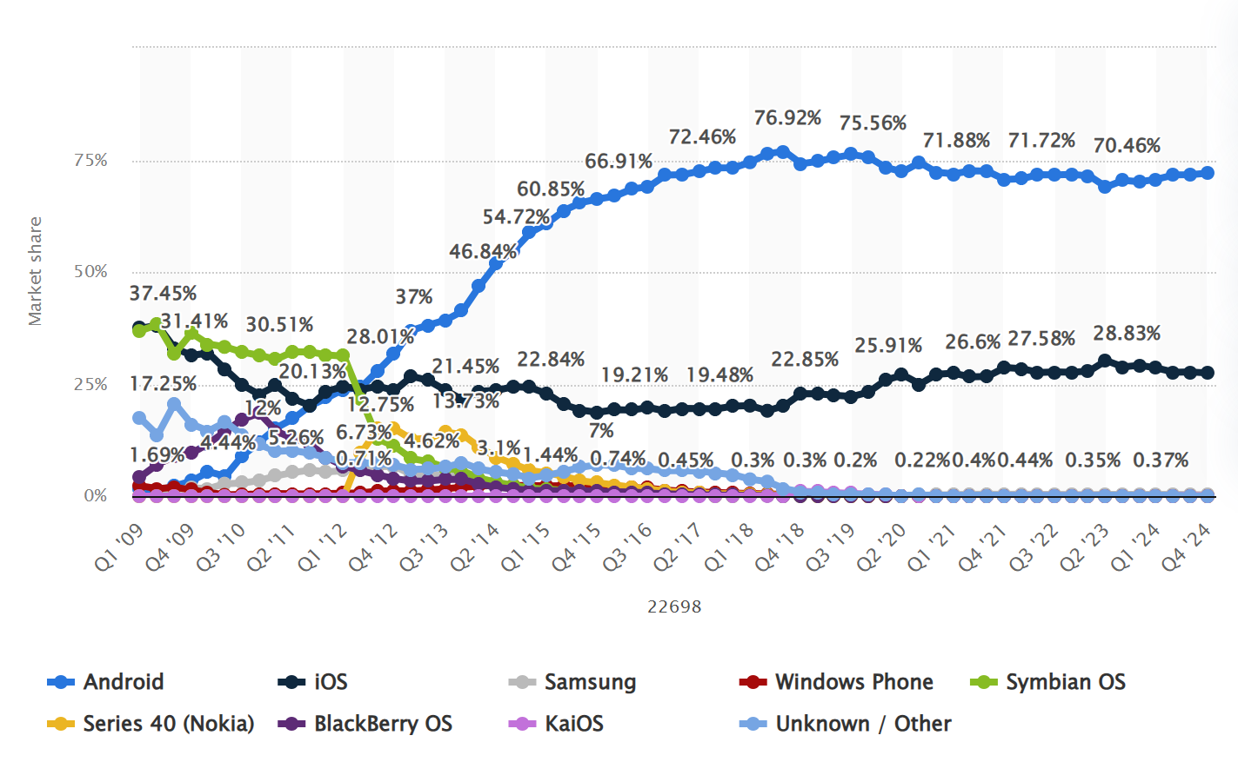
MKT SHARE OF MOB OS WORLDWIDE

Slide 7
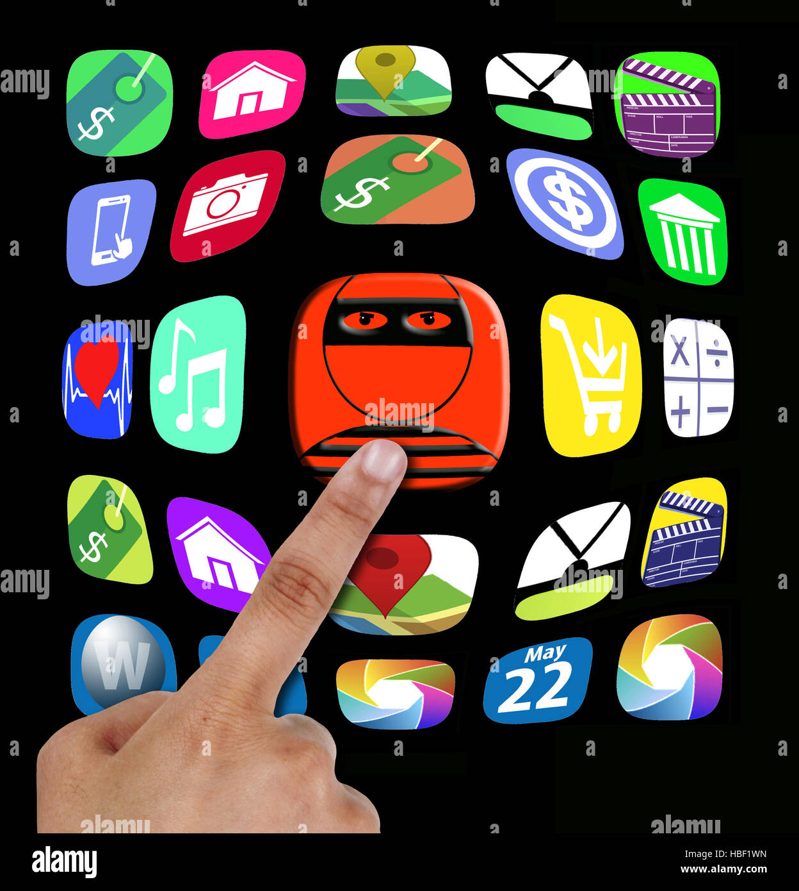
COMPARISON OF LEGITIMATE APPS WITH ILLEGITIMATE APPS
Fraudulent apps mimic genuine platforms to deceive users.
Common Lures.
Reward point redemptions.
Instant credit card approvals.
Hidden Dangers. Often contain malware to harvest sensitive info.
Key Findings.
Intercept calls and access SMS data.
Steal personal details (e.g., PAN numbers, Aadhaar, banking credentials).

Slide 8
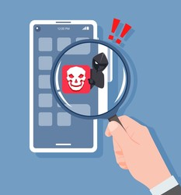
HOW TO IDENTIFY ILLEGITIMATE APPS
Excessive Permissions. Be cautious if an app requests access to sensitive features like SMS, call logs, or banking details.
Unverified Sources. Avoid downloading apps from third-party stores or links shared via SMS or email.
Too Good to Be True Offers. Apps promising unrealistic rewards or benefits are often red flags.
Changes to Phone Settings. Uninstall any app that alters your default SMS or call settings.

Slide 9
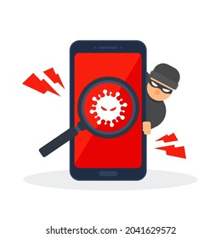
TRACKING VULNERABILITES IN SMART PHS
Malware
Phishing & Social Engineering
Unsecured Wi-Fi Networks
Weak Passwords & Biometric Security
Software Vulnerabilities
Physical Security Risks
App Store Risks

Slide 10

TRACKING VULNERABILITES IN SMART PHS : MALWARE
Definied as ‘Malicious software’ designed to harm devices.
Examples.
Ransomware. Locks device and demands payment for unlocking.
Spyware. Steals personal data (contacts, photos, location).
Adware. Displays unwanted ads.
Txn. Downloaded apps, infected websites, Bluetooth, Wi-Fi

Slide 11
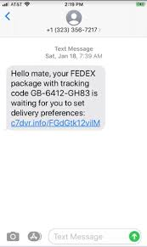
TRACKING VULNERABILITES IN SMART PHS : PHISHING & SOCIAL ENGG
Definied as ‘Tricking users into revealing sensitive information.’
Techniques.
Phishing. Deceiving users into clicking on malicious links or downloading attachments.
Social Engg. Manipulating users into performing actions (e.g., installing apps, providing credentials).
Examples. Fake websites, fraudulent calls, impersonation.

Slide 12
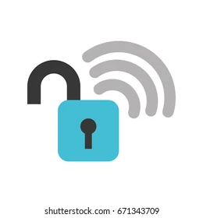
TRACKING VULNERABILITES IN SMART PHS : UNSECURED WI-FI NWS
Data transmitted over unsecured networks can be intercepted.
Examples. Public Wi-Fi hotspots, unsecured home networks.
Mitigation. Use VPNs, strong passwords, avoid sensitive activities on public Wi-Fi.

Slide 13
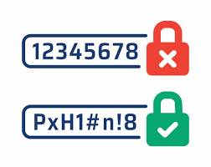
TRACKING VULNERABILITES IN SMART PHS : WEAK PASSWORDS & BIOMETRIC SECURITY
Easy-to-guess passwords can be easily cracked.
Mitigation.
Use strong, unique passwords (combination of uppercase, lowercase, numbers, symbols).
Enable biometric authentication (fingerprint, face recognition).

Slide 14

TRACKING VULNERABILITES IN SMART PHS : SW VULNERABILITIES
Flaws in the operating system or applications that can be exploited.
Examples. Operating system bugs, outdated software.
Mitigation.
Keep software and operating system updated.
Install security patches promptly.

Slide 15
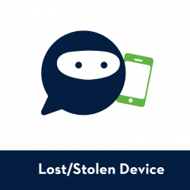
TRACKING VULNERABILITES IN SMART PHS : PHY SECURITY RISKS
Data loss and unauthorized access if devices are lost or stolen.
Mitigation.
Enable remote wipe and lock features.
Use strong device passcodes.
Be mindful of device location.

Slide 16
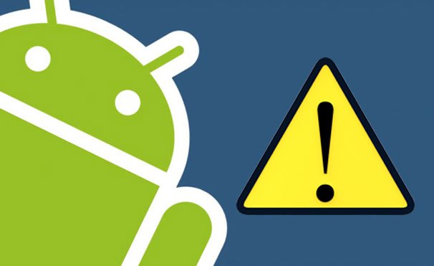
TRACKING VULNERABILITES IN SMART PHS : APP STORE RISKS
Malicious apps can infiltrate official app stores.
Apps may have hidden permissions or collect excessive data.
Mitigation.
Check app reviews and ratings.
Read app permissions carefully before installation.
Only download apps from trusted sources.

Slide 17
JAI HIND

